Slide 1
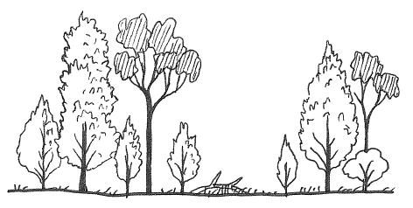
Planting a Random Forest
How to navigate an Infinite Dataset by Seeing the (Decision) Forest through the (Decision) Trees
Alan Underwood - April 5, 2024

Slide 2
Agenda: 30mins…ish
5mins Survey: How is preference formed?
5mins Demo: Window to the World
5mins Explanation: Seeing the Decision Forest through the Decision trees
10mins Background: How I got started with AI --------------------------------------------------------
5mins Architecture Deep Dive: How it Works (Don’t panic, we probably won’t have time for this)

Slide 3
Works Cited (2021-2023)
Decision Tree Algorithm Considering Distances Between Classes (2022)
https://ieeexplore.ieee.org/document/9810212
Visual and Linguistic Semantic Representations are Aligned at the Border of Human Visual Cortex (2021)
https://www.nature.com/articles/s41593-021-00921-6
Decoding Visual Neural Representations by Multimodal Learning of Brain-Visual Linguistic Features (2023)
https://arxiv.org/pdf/2210.06756.pdf
Sensory Perception Relies on Fitness-Maximizing Codes (2023)
https://www.nature.com/articles/s41562-023-01584-y

Slide 4
Works Cited (2021-2023)
The important part!
Decision Tree Algorithm Considering Distances Between Classes (2022)
https://ieeexplore.ieee.org/document/9810212
Visual and Linguistic Semantic Representations are Aligned at the Border of Human Visual Cortex (2021)
https://www.nature.com/articles/s41593-021-00921-6
Decoding Visual Neural Representations by Multimodal Learning of Brain-Visual Linguistic Features (2023)
https://arxiv.org/pdf/2210.06756.pdf
Sensory Perception Relies on Fitness-Maximizing Codes (2023)
https://www.nature.com/articles/s41562-023-01584-y

Slide 5
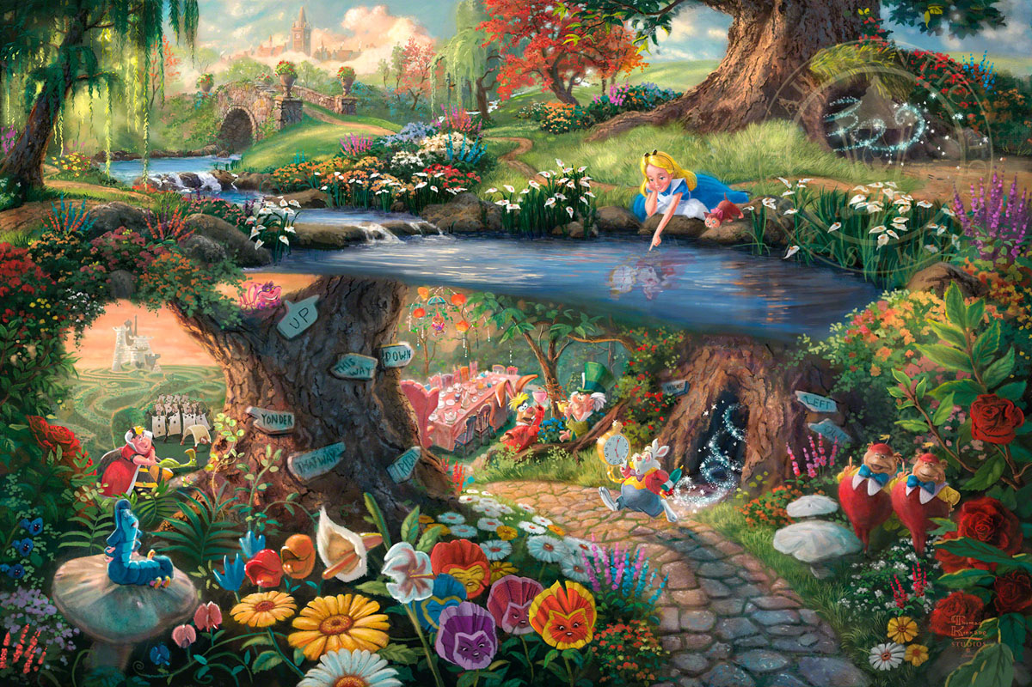
“I know who I WAS when I got up this morning, but I think I must have been changed several times since then.”
— Alice’s Adventures in Wonderland, Lewis Carroll

Slide 6
Survey: How is preference formed?

Slide 7
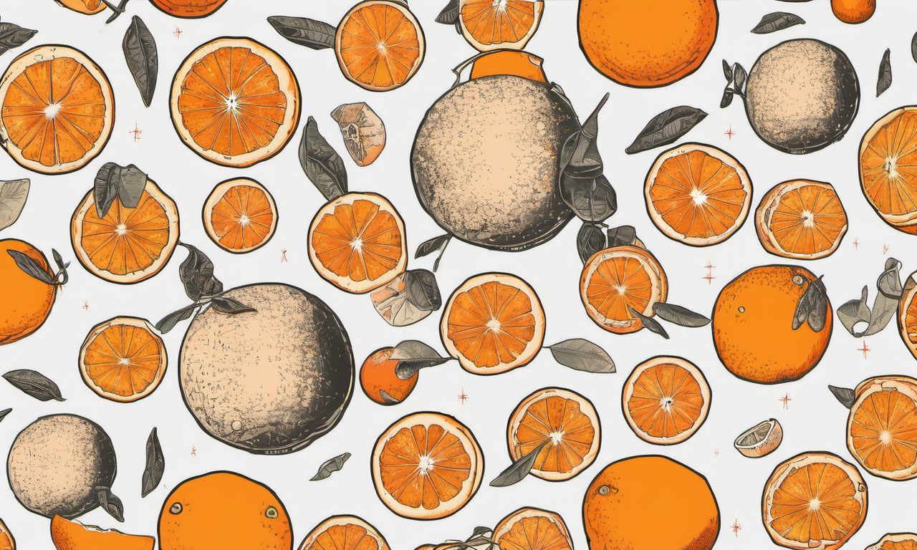
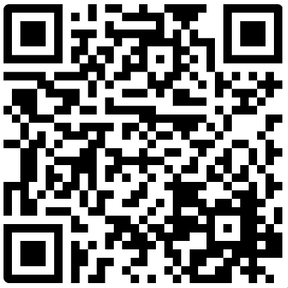
Survey: Oranges or Pluto? menti.com
5356 5874

Slide 8
Why do AIs such as GPT need human input at all?

Slide 9
Preference.

Slide 10
When navigating an infinite dataset, you need to know where to go.

Slide 11
Seeing the Random Forest through the Decision Trees

Slide 12
Random Forests

Slide 13
Decision Forests

Slide 14
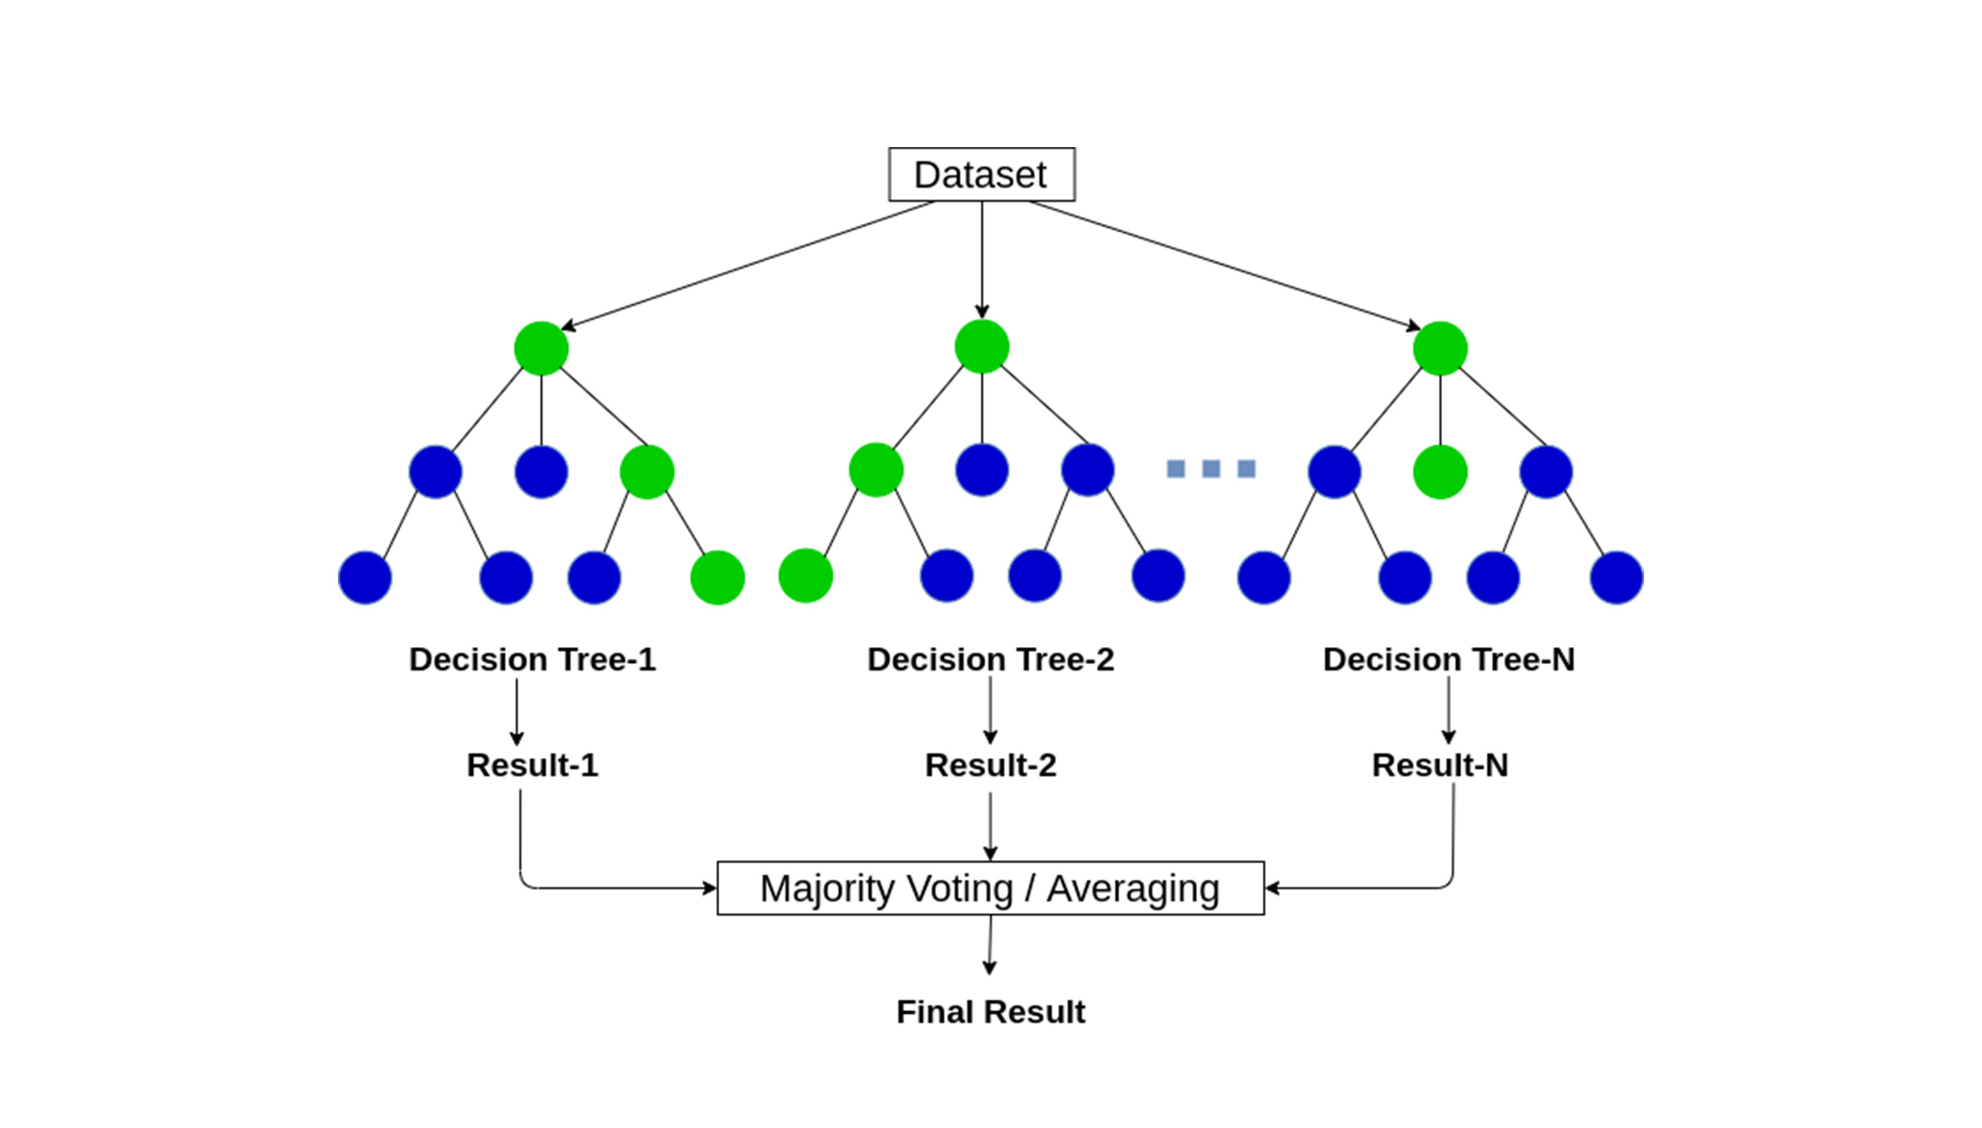
Random Forest
https://medium.com/@roiyeho/random-forests-98892261dc49 (2023)

Slide 15
Imagine an Infinite Plane

Slide 17
Imagine an Infinite Plane
Imagine an Infinite Dataset

Slide 19
How do you navigate… that?

Slide 20
Preference

Slide 21
Let’s try it…

Slide 22
Here is an “infinite” dataset of Gaussian Noise

Slide 23
Let’s navigate it together!

Slide 24
First, we make a decision:

Slide 25
First, we make a decision:
Start Here

Slide 26
Make another decision
Go Here

Slide 27
And another…

Slide 28
And another…

Slide 29
And another…

Slide 30
And another…

Slide 31
And another…

Slide 32
This is a Decision Tree

Slide 33
Another Decision Tree

Slide 34
This is a Decision Forest

Slide 35
Random Forest

Slide 36
Decision Forest

Slide 37
It may seem random, but is it?

Slide 38
How Did We Get here?

Slide 39
How Did We Get here?
Letting the Days Go By…

Slide 40
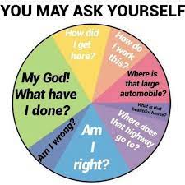
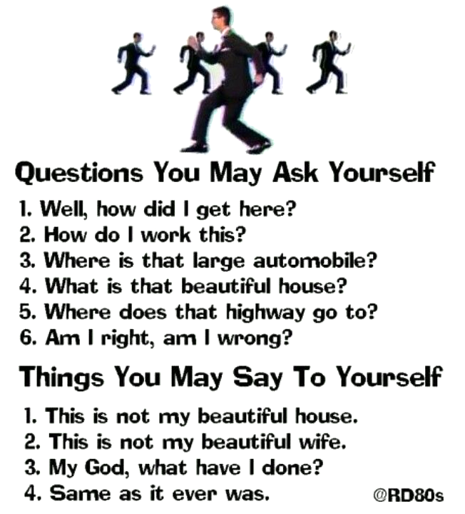

Slide 41
How Did We Get here?
Letting the Days Go By…
By expressing a preference.

Slide 42
How can you start with AI?

Slide 43
How can you start with AI?
Letting the Days Go By…
Start with a preference.

Slide 44
How can you start with AI?
Letting the Days Go By…
Make a Decision

Slide 45
How can you start with AI?
Letting the Days Go By…
Make another Decision

Slide 46
Demo: Window to the World

Slide 47
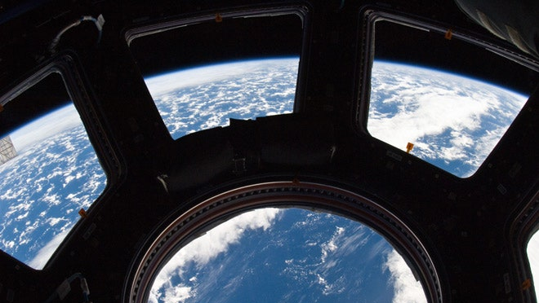

Slide 48
Why is it called Window to the World?

Slide 49
Preference is solid

Slide 50
Preference is invisible

Slide 51
Like a... window

Slide 52
Preference is a Window to the World

Slide 53
Every Window is a Door if you’re brave enough to go through it.

Slide 55
How did you get started with AI?

Slide 56
How do I get started with AI?
But what they’re really asking is…

Slide 57
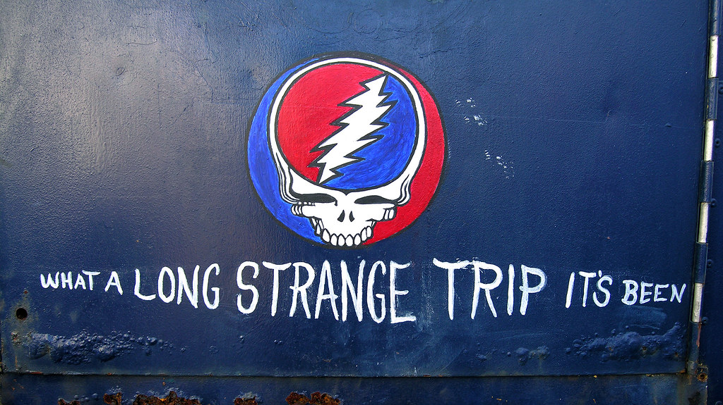

Slide 58
2011: IBM Watson defeats Ken Jennings
Watson’s main innovation centered on its ability to quickly execute hundreds of algorithms to simultaneously analyze a question from many directions, find and score potential answers, gather additional supporting evidence for each answer, and evaluate everything using natural language processing. The more of its algorithms that independently arrived at the same answer, the higher Watson’s confidence level. If the confidence level was high enough, Watson was programmed to buzz in during a game of Jeopardy! If not, Watson wouldn’t buzz. Watson performed all of these calculations in about three seconds.

Slide 59
Naïve Bayesian Classifiers

Slide 61
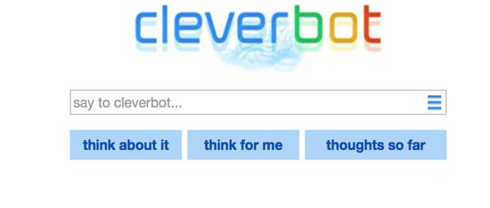

Slide 62
ChatBot

Slide 63
ChatBot

Slide 64
CatBot

Slide 65
Mew Meu Mao Miaav Miauw Miau Naiou Miau Miya Miaou Miao Мяу Nyan Yaong Miyav Mjau Nyávog Myaun Miu Miaw Miaun Mňau Meong Mjá Myau Myaw Miaw Mroang Miayeut Meach Miaauw Ngiyavuma Maw Meaw Gihiya
“Meow” Around the World

Slide 66
CatBot actually shipped…

Slide 67
CatBot Enterprise

Slide 68
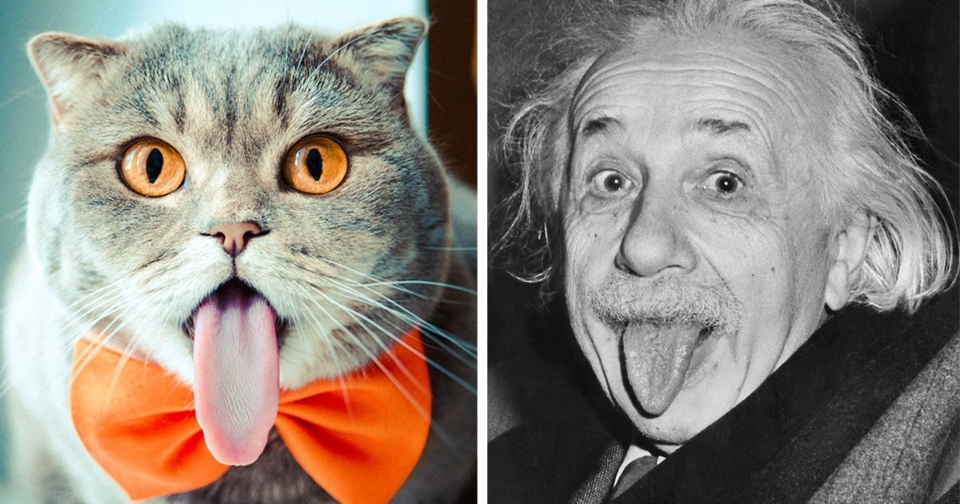

Slide 69
Cats are actually really smart.
But… it turns out that

Slide 70
Model Organisms
Organism Neurons
Albert Einstein 86,000,000,000
Crow 1,500,000,000
Cat 760,000,000
Chicken 220,000,000
Bee 960,000
Ant 250,000
Zebrafish 200,000
Fruit Fly 150,000
Round worm 302
Yeast 0

Slide 71
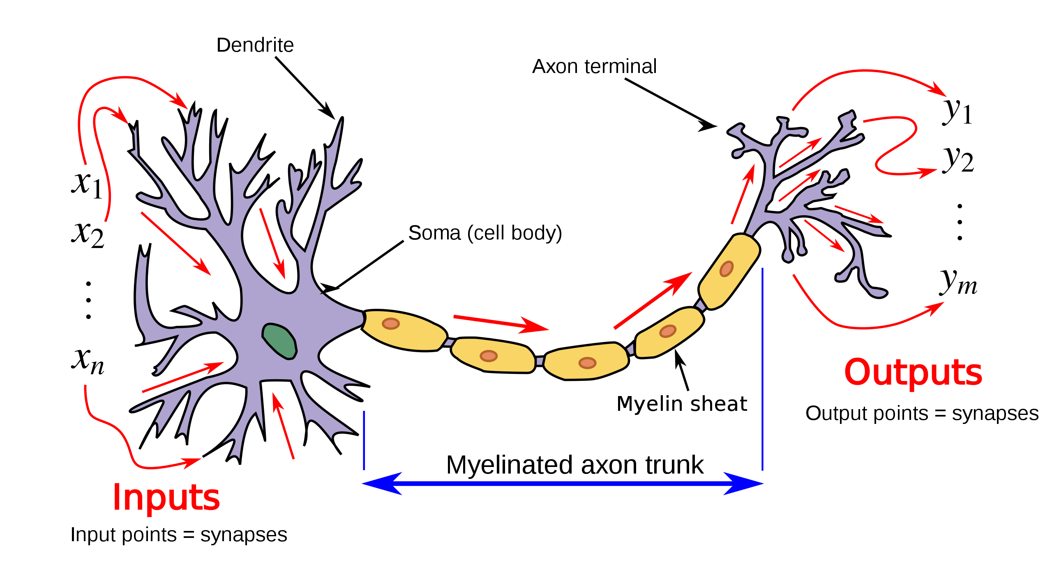
Biological Neuron

Slide 72
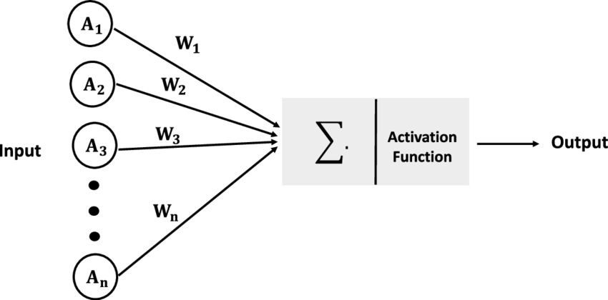
Artificial Neuron (1943)

Slide 73
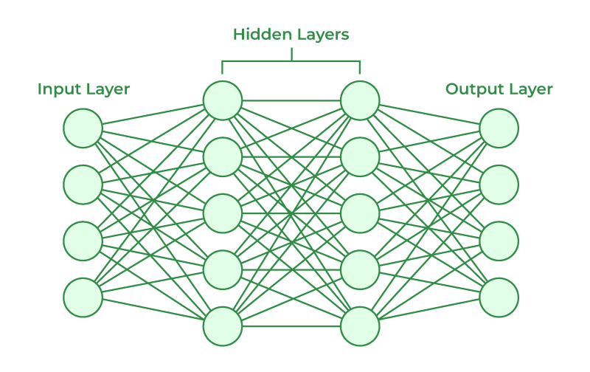
Artificial Neural Nets (1980)

Slide 74
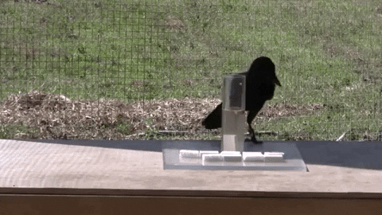

Slide 75
Birds are really smart too.

Slide 76
Fish?

Slide 77
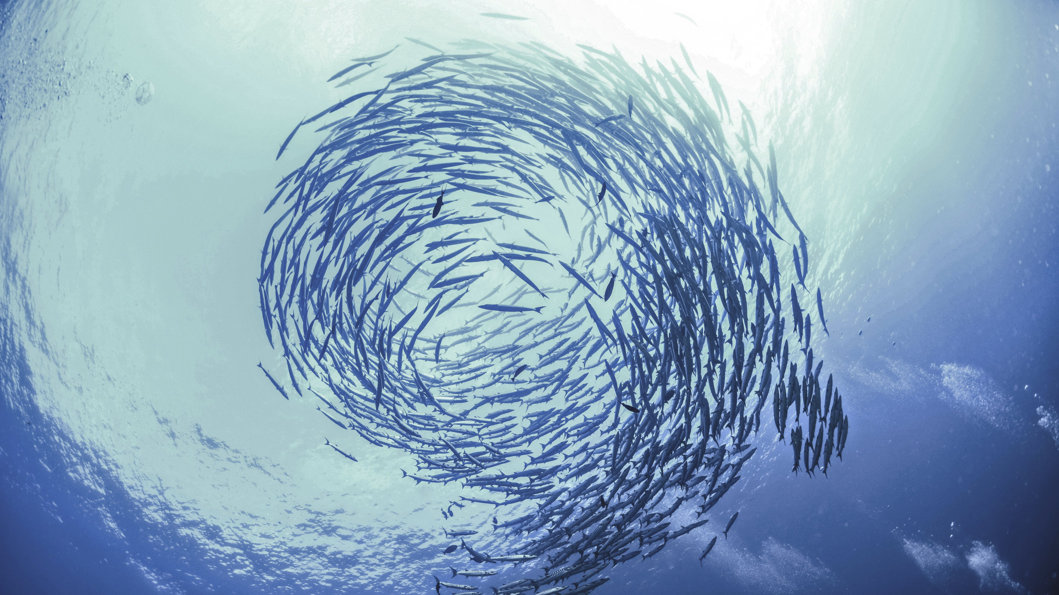

Slide 78
What about insects?

Slide 79
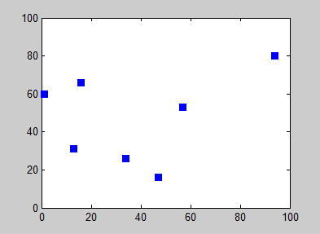
Traveling Salesman Problem

Slide 80
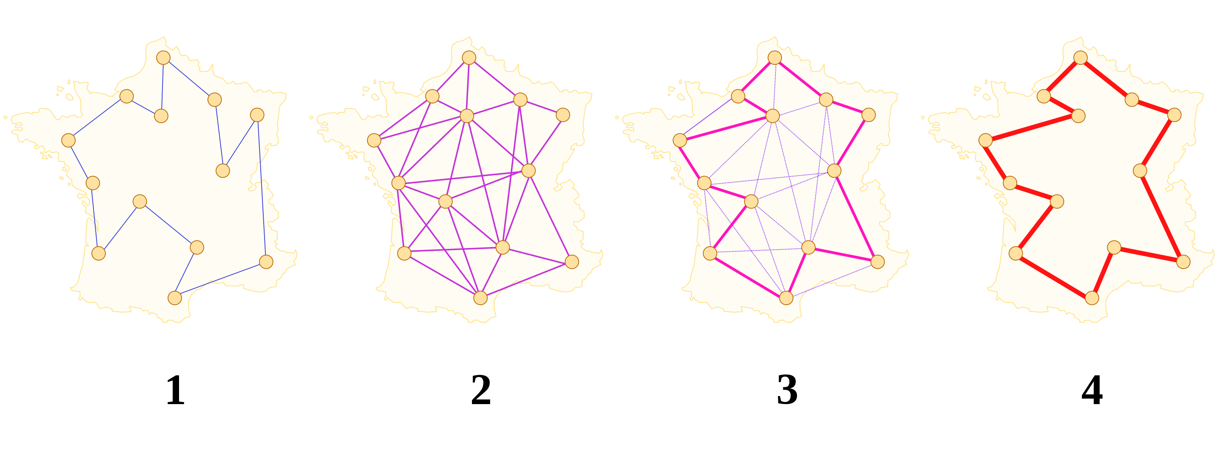
Ant Colony Optimization

Slide 81
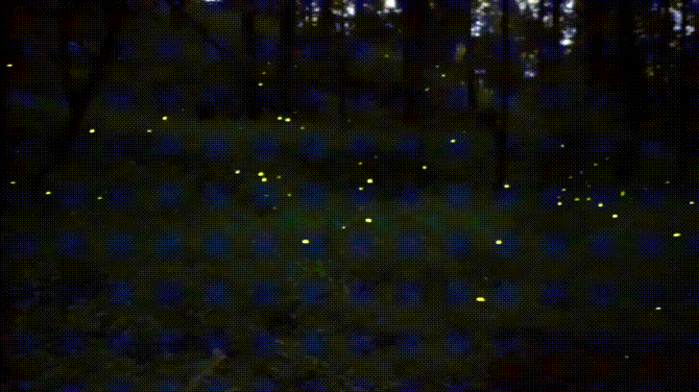
“Time flies like an arrow.
Fruit flies like a banana.”
— Groucho Marx (maybe)

Slide 82
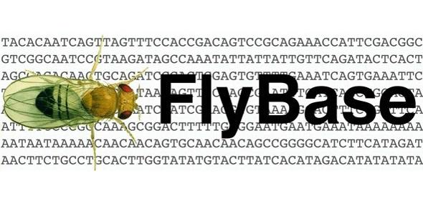

Slide 84
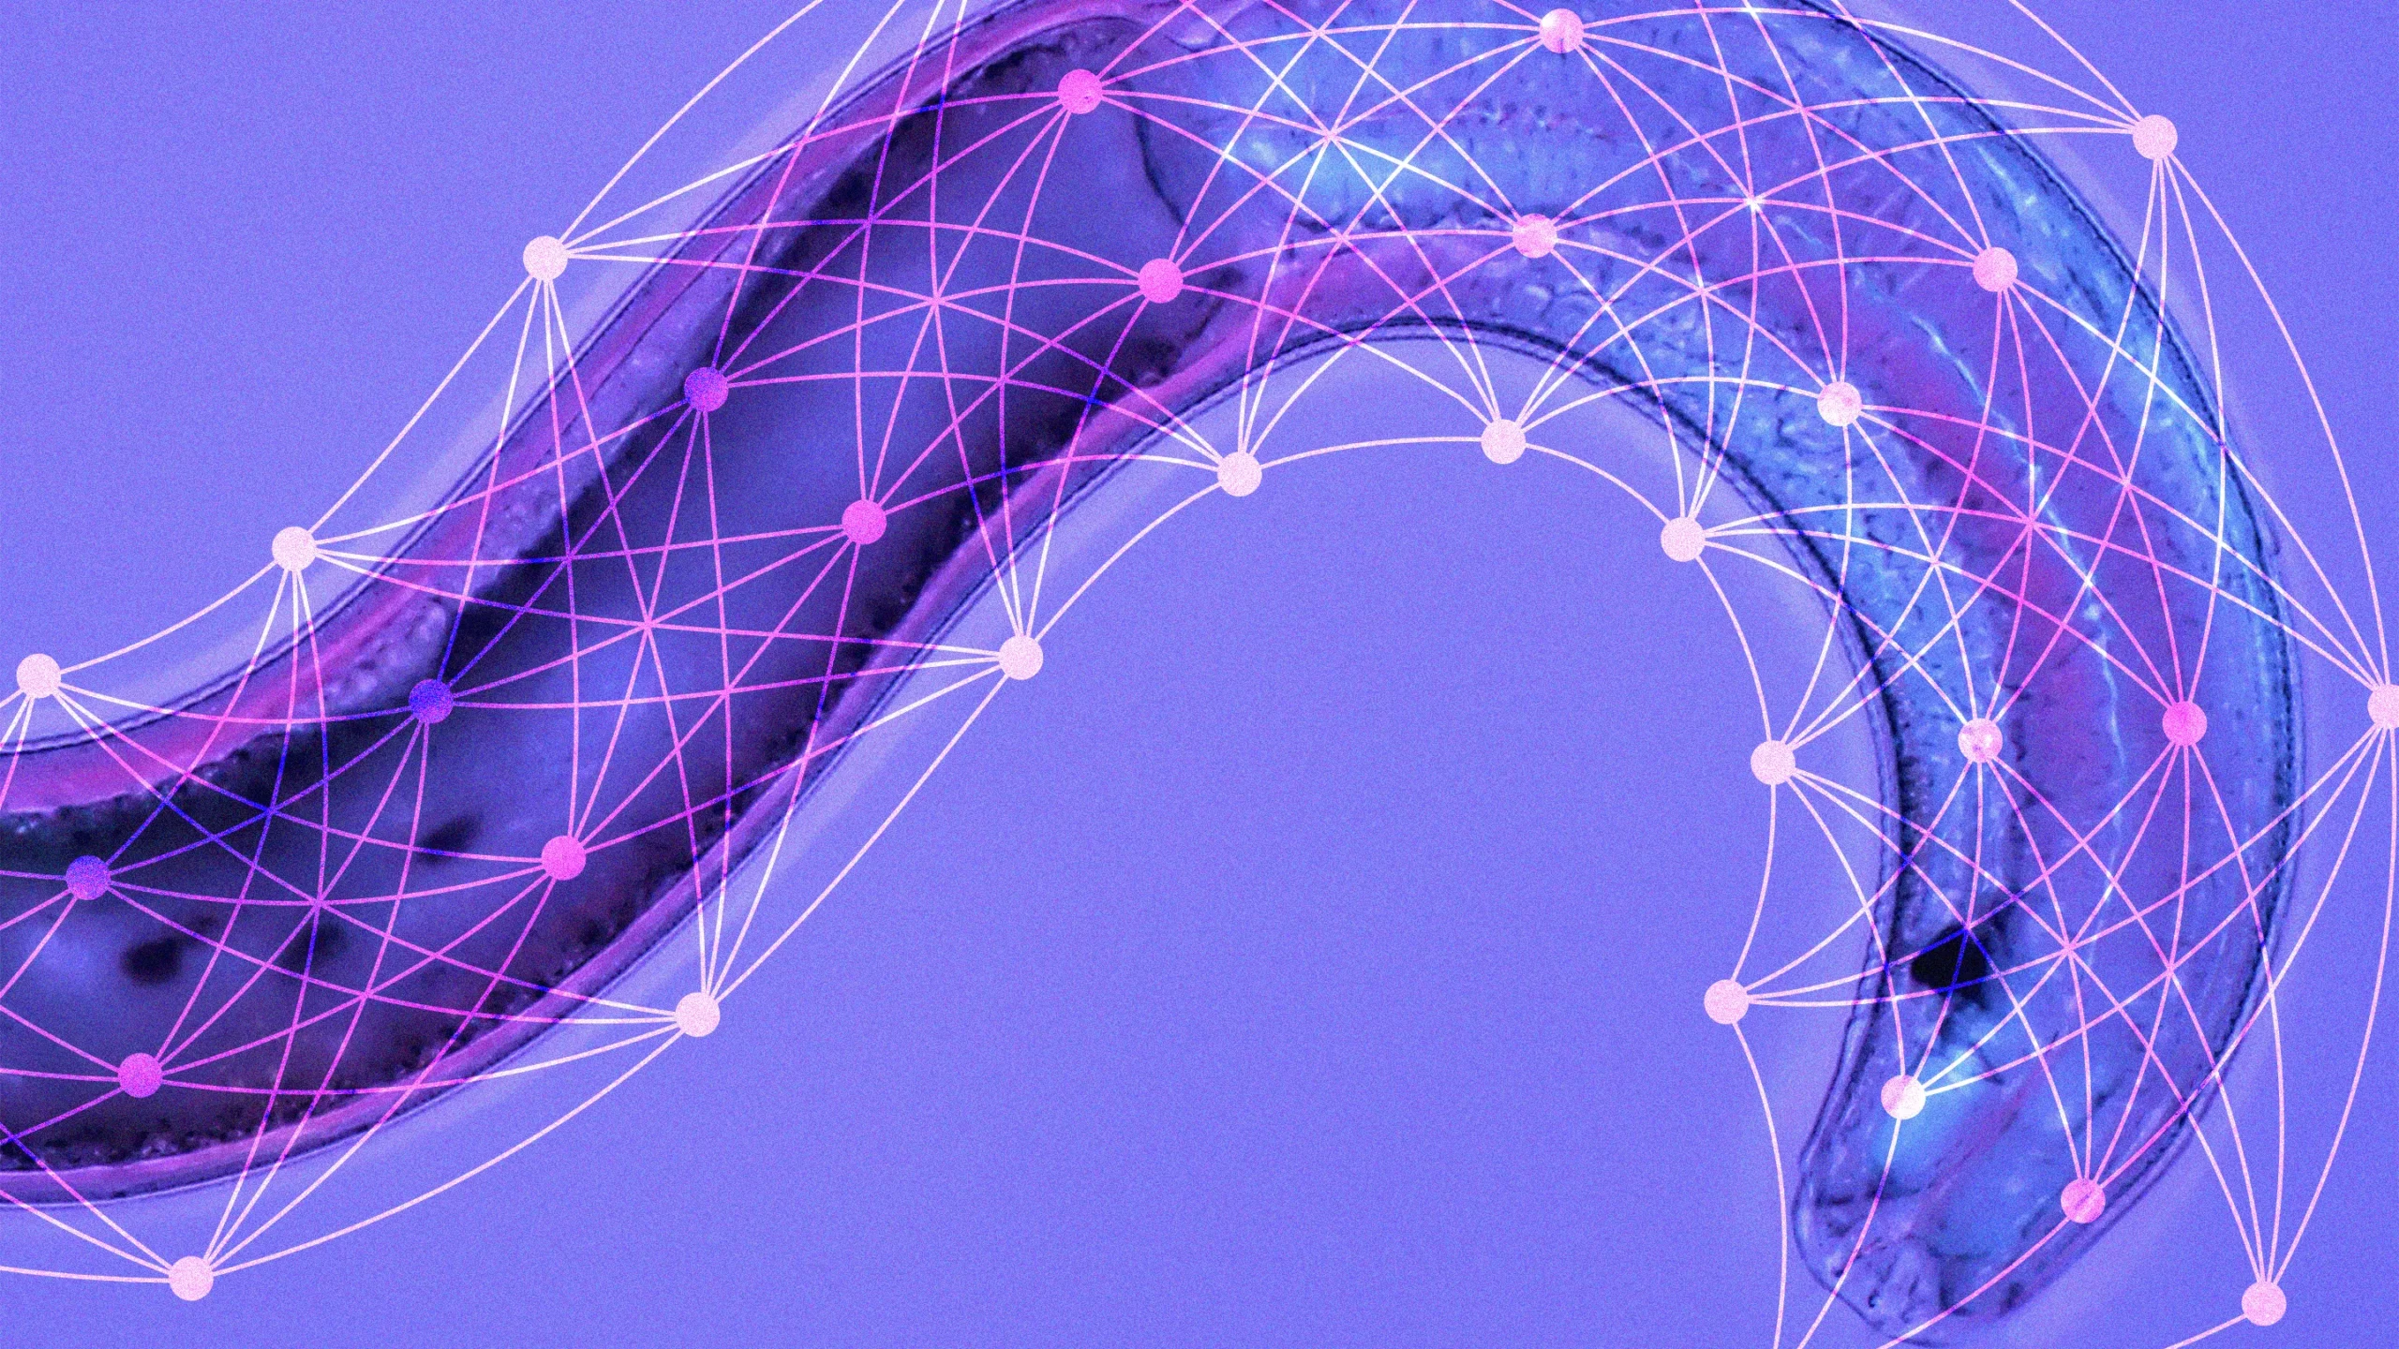
“Liquid” neural nets, based on a worm’s nervous system, can transform their underlying algorithms on the fly, giving them unprecedented speed and adaptability.
— Liquid Time-Constant Networks (2020)

Slide 85
Model Organisms
Organism Neurons
Albert Einstein 86,000,000,000
Crow 1,500,000,000
Cat 760,000,000
Chicken 220,000,000
Bee 960,000
Ant 250,000
Zebrafish 200,000
Fruit Fly 150,000
Round worm 302
Yeast 0

Slide 86
What about… yeast?
Surely, I can’t be outsmarted by a micro-organism, right?

Slide 87
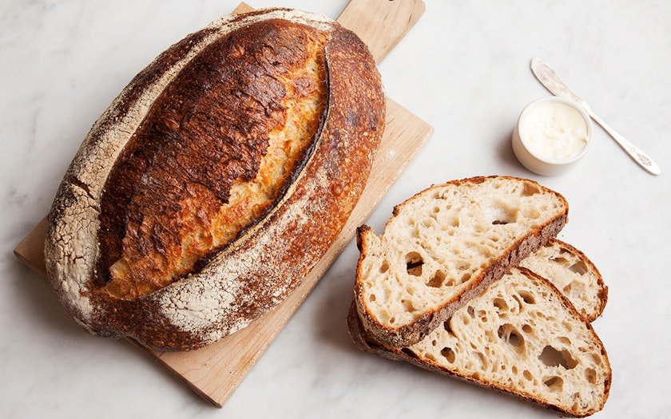
“Falling between order and chaos, the moment of complexity is the point at which self-organizing systems emerge to create new patterns of coherence and structures of relation.”
— The Moment of Complexity: Emerging Network Culture

Slide 88
Self Organizing Systems

Slide 89
Bread Based Algorithm
Flour = Fungible Tokens
Water = Liquid architecture
Salt = Non-Fungible Tokens
Yeast = User Interaction
Rise over time and then bake until set

Slide 90
Window to the World
Flour = Images
Water = Asynchronous architecture
Salt = Advertisements (NFT)
Yeast = Preference
Rise Train and then bake until set

Slide 91
Bread Based Algorithm
Flour = Images
Water = Asynchronous architecture
Salt = Advertisements
Yeast = Preference
Rise Train and then bake until set

Slide 92
Architectural Deep Dive: Window to the World

Slide 93
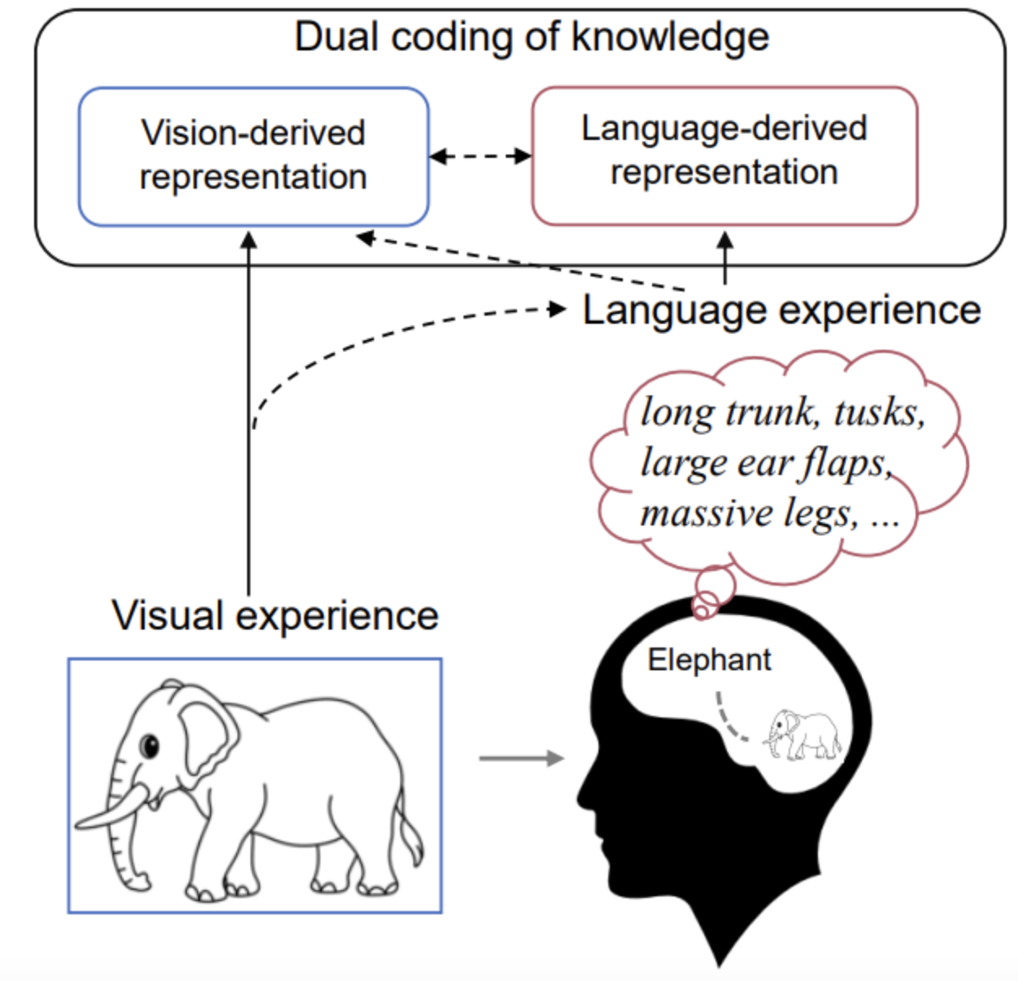
Decoding Visual Neural Representations by Multimodal Learning of Brain-Visual Linguistic Features (2023)
https://arxiv.org/pdf/2210.06756.pdf

Slide 94
Visual and Linguistic Semantic Representations are Aligned at the Border of Human Visual Cortex (2021)
https://www.nature.com/articles/s41593-021-00921-6

Slide 95
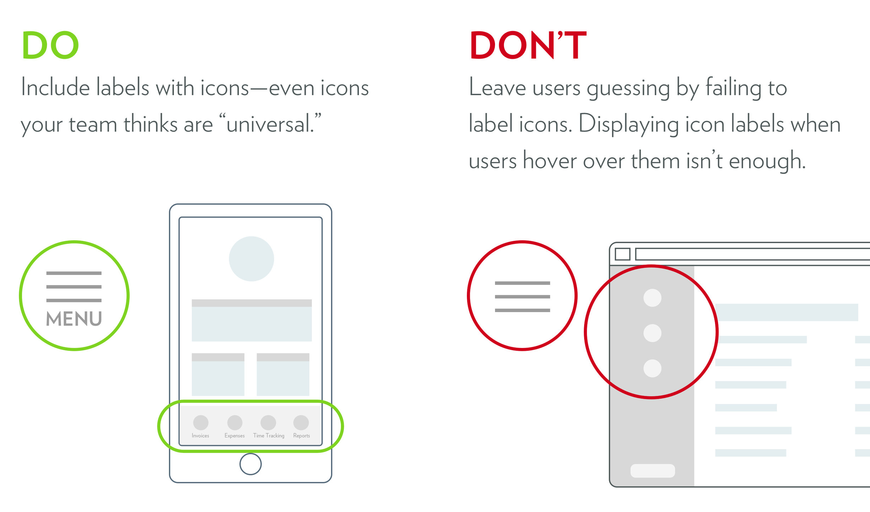
Decoding Visual Neural Representations by Multimodal Learning of Brain-Visual Linguistic Features (2023)
https://arxiv.org/pdf/2210.06756.pdf

Slide 96
Sensory information encoded by humans and other organisms is generally presumed to be as accurate as their biological limitations allow.
However, perhaps counterintuitively, accurate sensory representations may not necessarily maximize the organism’s chances of survival. Behavioral experiments in humans revealed that sensory encoding strategies are flexibly adapted to promote fitness maximization.
Sensory Perception Relies on Fitness-Maximizing Codes (2023) https://www.nature.com/articles/s41562-023-01584-y

Slide 97
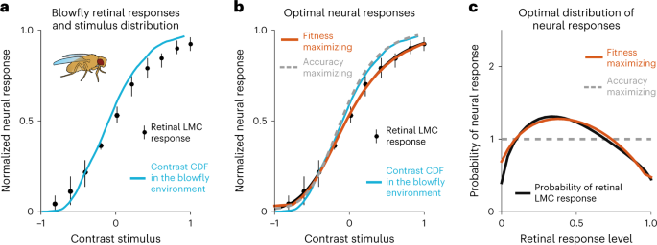
Preference = Fitness

Slide 98
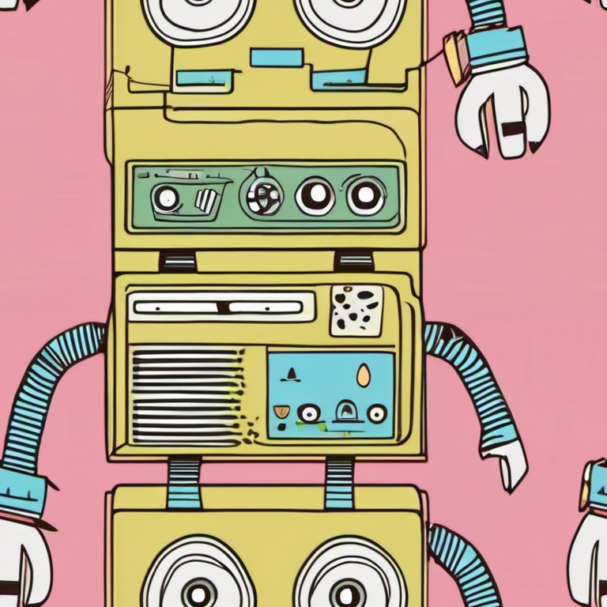
“You’re not going to beat centralized AI with more centralized AI.”
— Emad Mostaque, former CEO of Stability AI, March 22, 2024

Slide 99
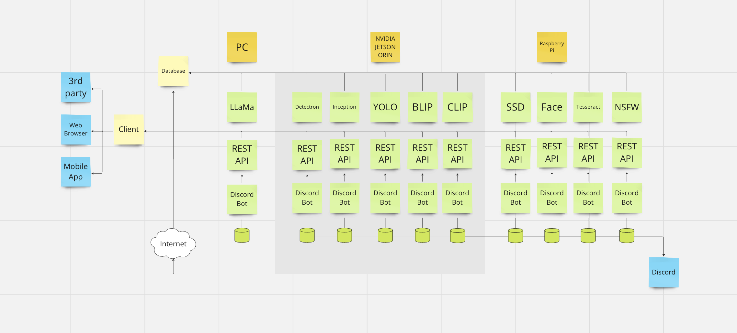
Distributed REST Architecture

Slide 100
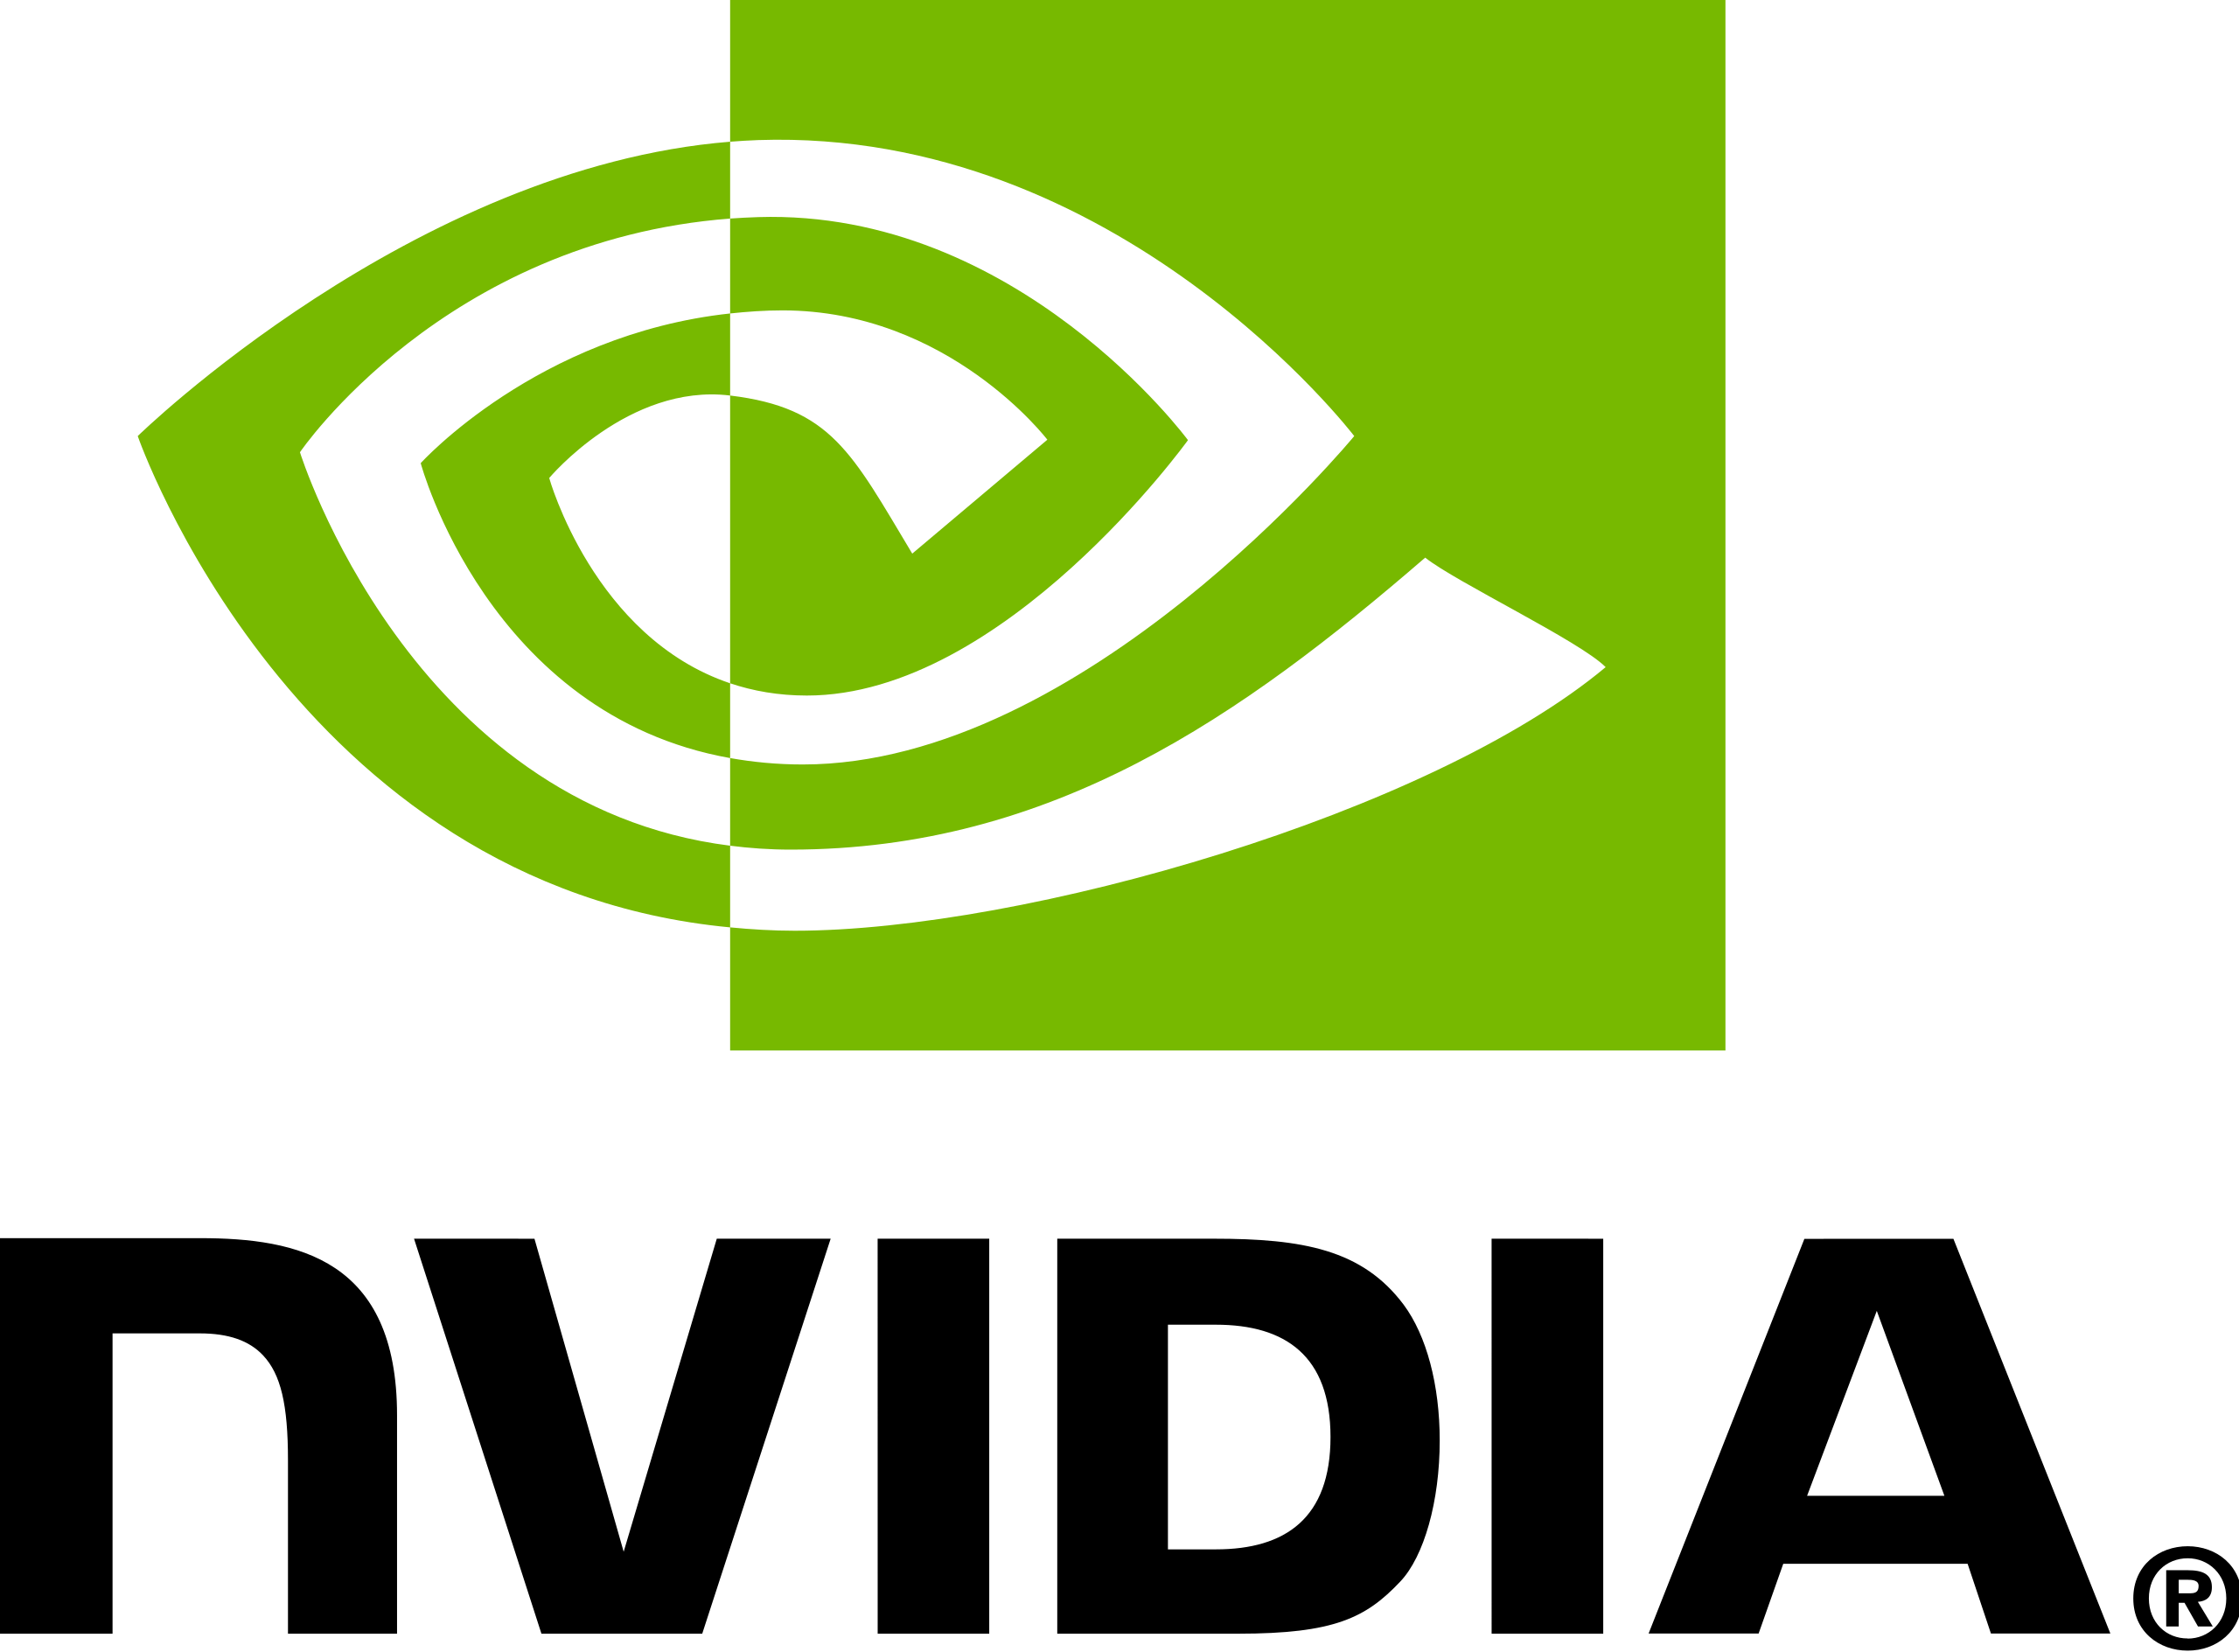
Technology Stack
Software
Python
Torch
TensorFlow
HTML
CSS
JavaScript
Bash
PHP (Proxy)
NodeJS
Hardware (cloud)
RTX 6000
3090ti
Edge Computing
Jetson Orin (5)
Raspberry Pi (6)

Slide 101
Liquid Architecture
Capacity
Add Copies of Existing Bots
Add new bots or training sets to the network
Capability

Slide 102
Works Cited (2021-2023)
Decision Tree Algorithm Considering Distances Between Classes (2022)
https://ieeexplore.ieee.org/document/9810212
Visual and Linguistic Semantic Representations are Aligned at the Border of Human Visual Cortex (2021)
https://www.nature.com/articles/s41593-021-00921-6
Decoding Visual Neural Representations by Multimodal Learning of Brain-Visual Linguistic Features (2023)
https://arxiv.org/pdf/2210.06756.pdf
Sensory Perception Relies on Fitness-Maximizing Codes (2023)
https://www.nature.com/articles/s41562-023-01584-y

Slide 103
Unconventional Works Cited (1941-2001)
The Garden of Forking Paths (1941)
Jorge Luis Borges
Computing Machinery and Intelligence (1950)
Alan Turing
Leverage Points: Places to Intervene in a System (1997)
Donella Meadows
The Bread Baker’s Apprentice (2001)
Peter Rheinhardt

